Slide 1
1
2
3
Notes:
FTM grew by 24,026
2000 – 35,234 (what percentage fill of requirements is this?)
2011 – 59,270 (what percentage fill of requirements is this?)
What type of personnel are included in the 59,270 (Full time equivalents (FTEs), ADOS, MOB Augmentees, , contractors, etc and was the increase due to budget increase , ie OCO funding?
Used FY 11 figures versus FY-13 for end strength
Guard budget grew to $16.2 Billion – what is included in this figure (OCO and supplemental appropriations?) Used FY 11 figures versus FY-13
The 570k is the “surge” FSA the Army never actually reached. The more appropriate figure would be the pre-9/11 figure of 490k – but this only depicts a FSA reduction of 70K in the Army as opposed to the 150k as listed
Per the Army’s report to the House Armed Services Committee , Sub-Committee on Personnel:
Though the NDAA Authorized 570K, Actual End Strength peaked at approximately 540K in2010
Reality is:
AC at 482k on 9/11….reducing to 420k is a 12.8% redux (62k personnel redux) (According to RFPB, you can maintain 186k ARNG at the same cost.
ARNG at 350k on 9/11….reducing to 315k is 10% redux (35k personnel redux)
AC reduces to 450k, it is a 6.6% redux (32k personnel redux) Based solely on Sequestration not being reimposed after FY15
ARNG reduces to 335k, it is a 4.2% redux (15k personnel redux) Based solely on Sequestration not being reimposed after FY15
The limitations on getting BCTs to the fight are Strategic Lift (Air and Sea). Why rely heavily on AC BCTs that cost 3-4 times as much but can’t get to a fight any faster due to these limitations-while maintaining capabilities for the Homeland and Governors?

Slide 2
1
2
3
4
5
6
Notes:
1. Wartime Demand and Armed Aerial Scout
From 2001 through 2013 there were 12 Battalion Sized Request for Forces (RFF) approved by the Joint Staff and tasked by FORSCOM to the NG. All 12 RFFs were filled by the NG.
In addition to the BN RFFs, 4 RFFs for Battalion (-) or Company sized missions were tasked to the NG, all 4 RFFs were filled
Armed Aerial Scout/Armed Reconnaissance Squadron – alternative proposals are provided that maintain AH64 in the NG while filled the AAS/ARS mission through Multi-Component Aviation Brigades
Keeps AH in the Guard
Significantly reduces the Transition Requirement for OH to AH and AH to UH across Compo 1 and 2 (reduction of 80%)
111 UH-60 to the Guard (Already scheduled due to inactivation of 3xAC Aviation Brigades – nothing new here)
Current UH60 Authorizations for the Guard are short by approximately 20% when compared to Requirements
Based on the published UH60 Fleet Management Plan, Aircraft coming to the Guard do not meet the A to L or A to M transition requirements (Upgrades) – relegating the Guard to older airframes with no planned or funded modernization plan
Additional 100 UH-72s are not in the POM and based on current procurement rate would take approximately 4.5 years to acquire – leading to a degradation of the NG UH72 availability
Inactivation of 2 x Combat Aviation Brigades (CAB) was planned prior to Aviation Restructuring – 159th CAB at Ft Campbell, KY and 12th CAB in Germany
Only 2 x CABs worth of equipments would be available as the remaining inactivated CAB equipment set remains in place in Korea for rotational CABs
“Loss of 687 Aircraft to AC” – Actual Loss is 441, less than 2 x CAB of aircraft
191 are TH67 at the training base – Ft Rucker, AL
55 are OH58D at the training base – Ft Rucker, AL
Guard net loss of 111 aircraft
Guard is currently short approximately 70 UH60
What Force Structure and Full-time Manning (FTM) would come to the state with “about two aircraft per state”?
Current ARB Structure: Approx 450 Soldiers, Approx 165 FTM (AGR, Mil Tech)
Governor (NC) currently has sufficient capacity (UH60) to respond to Cat 1-3 Hurricane with EMAC in place for Cat 4/5 Hurricanes.

Slide 3
1
4
2
3
Notes:
Only aircraft are mentioned – what about force structure authorization?
The Army plans to take 192 Apaches out of the Guard along with the Attack Recon Battalion Structure
The Guard will get back 111 UH-60 Blackhawks – but no mention of FSA such as a Assault Helicopter Battalion (AHB) to replace the lost ARB force structure
This will mean that NGB will pull companies from existing AHB or even down to detachments and station in states where ARBs are pulled and replaced with UH-60 Blackhawk helicopters
US Army Reserve gave up 48 AH-64D Apaches and ARB structure – and in return got a one-for-one swap with UH-60 Blackhawks and AHB force structure
There will be in access of the 192 Apaches that will be stationed in other than Active Army Apache units (30 already excess of 2030 endstate; 30+ at Ft. Rucker; 40+ ORF; 24+ in Korea) – enough to maintain 6 x CABs (18 Apaches O/H) flying in the National Guard.
Full-time support reduction of 10% - what number will be used for the 10% reduction – the inflated number from 2011 that includes FTE, ADOS, MOB Augmentees, etc)?
While Governors will retain adequate aviation assets to support domestic operations – and in fact see an increase in the number of UH-60 Blackhawks, there will be a tremendous loss in associated ground support equipment and rolling stock.
a. DOMOPS capability lost:
Aviation Command and Control
24 HEMMTs (truck)
28 LMTVs (truck)
29 HMMWV (truck)
3 forklifts
2 Mobile Kitchen Trailer
27 generators
4. Active component BCT growth was disproportional from FY00-FY13 going from 33 BCTs in FY00 to 45 BCTs in FY13 (36% growth). The ARNG on the other hand was already reducing BCTs from 42 BCTs in FY00 to 28 BCTs in FY13 (33% reduction). The Guard has already reduced it’s inventory of BCTs and going down further to 22 BCTs would actually be a reduction of 48%. The Strategic hedge for our security lies in keeping the reserve component strong so that the nation has a force that can be rapidly trained to collective BCT level proficiency and deployed to meet threats. Without the reserve capacity, the country’s security is at risk.

Slide 4
1
Notes:
This is the Army’s real end-game. Make the proposed cuts and reductions to the Reserve Components, specifically for the National Guard, that elected official resort to protecting the National Guard assets and force structure and approve additional funding for the Army to procure the shortfalls identified in equipment.

Slide 5
SUPPLEMENT

Slide 6
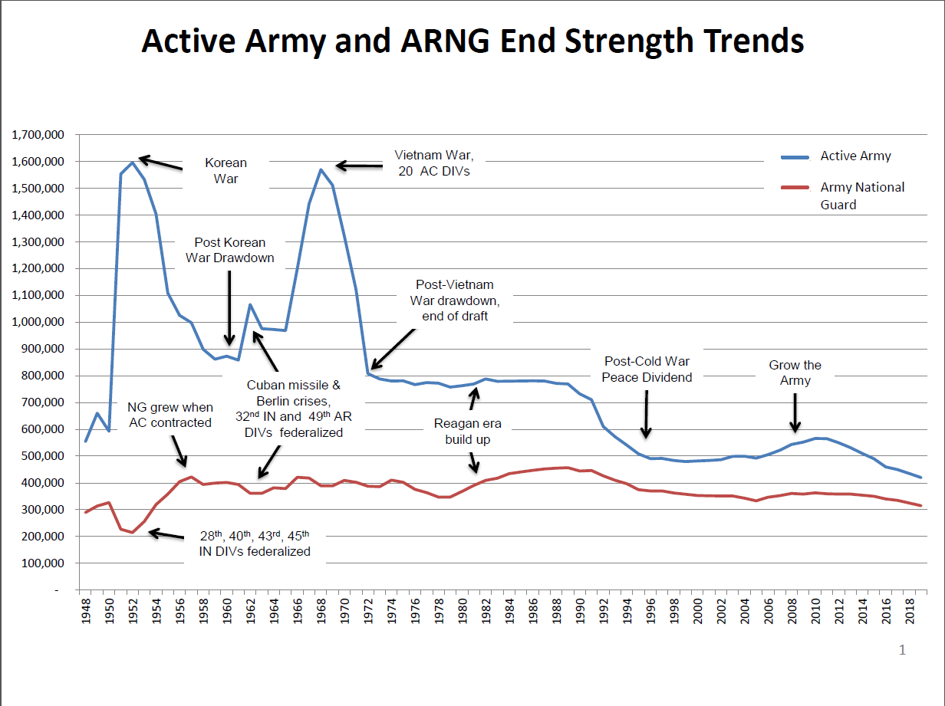
Notes:
ARNG has historically maintained its FSA and ES between 350k and 400k as a strategic hedge against unforeseen contingencies. If the Nation were to adopt successful business practices, we would size the Active Components to meet the lowest demand signal required and leverage the Reserve Components for anything above that (FEDEX uses this principle). Had we mobilized more ARNG BCTs during the two-theater surges, we would not have “temporarily” hired so many additional full time Soldiers.
The amount of resources (e.g. money and time) leveraged to attain Reserve Component readiness levels is an Army decision. If they determined to provide more, the readiness levels of Reserve Components would increase.

Slide 7
Notes:
AC Army was authorized “temporary” Force Structure and End-strength growth in order to support the “Surges” in Iraq and Afghanistan – prosecuting two simultaneous contingency operations.
ARNG was authorized “temporary” Force Structure and End-strength growth in order to support operations in Iraq and Afghanistan.
The “real” reductions in forces, as submitted in the PB 15 are (based upon pre-9/11 permanent force structure allowances and end-strength) are:
AC Army: 484,000 to 450,000 vs. 570,000 to 450,000
34,000 total redux 120,000 total redux
7% total redux 21% total redux
ARNG: 350,000 to 335,000
15,000 total redux
4.3% total redux
The reduction in BCT proposed in the PB15 is more a reduction in headquarters and not in combat formations. The BCTs will go from a 2 Maneuver Battalion unit organization to a 3 Maneuver Battalion organization….the loss of 1 BCT equates to a loss of XXXX personnel assigned to the BCT headquarters only.

Slide 8
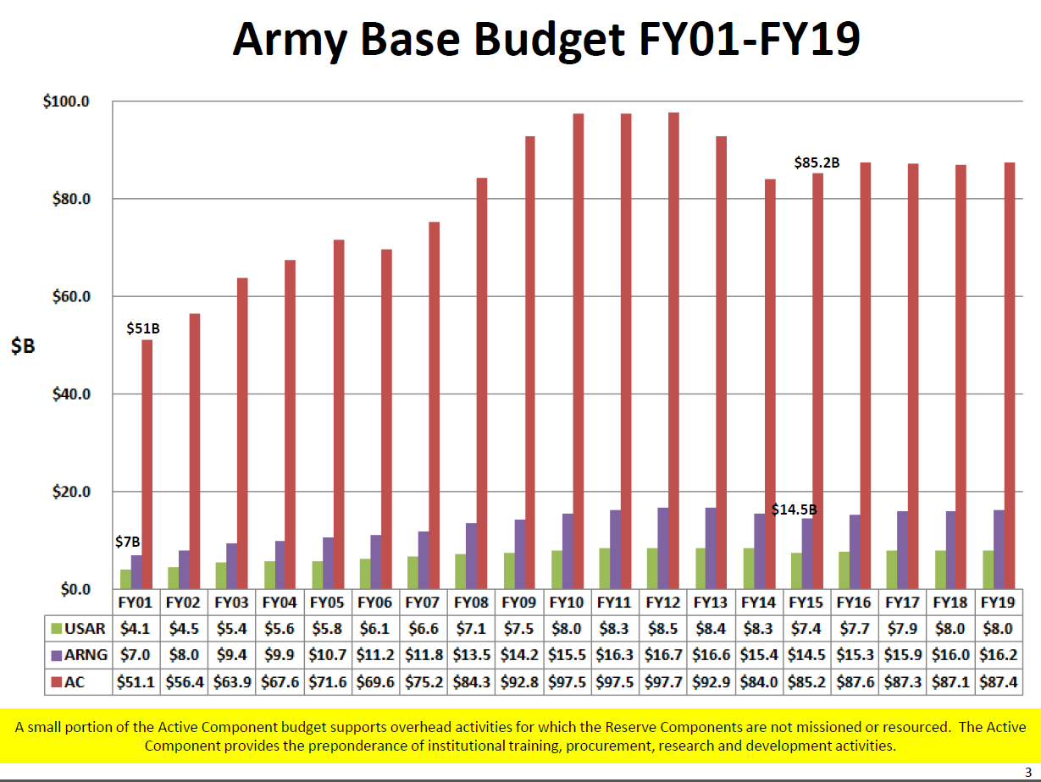
Notes:
The Active Duty Army budget grows in FY15 to $ 85.2 Billion - Growth of 1.4%
The ARNG budget reduces to $ 14.5 Billion in FY15 – Reduction of 5.8%

