Slide 1
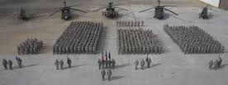
Generating Combat Power:
AC and ARNG Attack/Recon Battalions (ARBs)
Myth: Highly Trained AC ARBs are Safer.
Fact: 15 AH-64D Class A Accidents in last 5 FY (09-13).
Pilot Error (Causal or Contributing Factor) in 10 of 15. All 10 Pilot Error were AC Aircrew. Only 2 Class A involving ARNG, both caused by Material Failure, no pilot error.
Myth: ARNG ARBs are inexperienced “Weekend Warriors” who only train minimally.
Fact:
•ARNG ARBs train 4-6 days a week and routinely train multi-spectrum ops with USAF, USN, SF, Rangers, etc.
• ≈ 1/3 of ARNG ARB personnel are full-time.
•Full -time experience ≈ 15 yrs (avg.)
M-day (part-time) experience ≈ 10 yrs (avg.)
•ARNG ARB ≈10x CW4. (AC ≈4x CW4 per ARB.)
Myth: ARNG dwell times are too long, reducing availability.
Fact: FORSCOM established the ARFORGEN Cycle which determines dwell times. Aside from AH-64D fielding, ARNG Bns deployed with shorter than published dwell times.
Myth: ARNG ARBs not sufficiently accessible for deployments.
Fact: Majority of AH-64D Fielding for AC complete before OIF/OEF. All ARNG ARBs were fielded Longbows during OIF/OEF and non-deployable 3+ years due to the Fielding Schedule. AC controlled the fielding and deployment schedule. 12 requests were made for ARNG support, ARNG deployed 12 times. ARNG ARBs deployed 100% of the time they were requested.
AR
Myth: AC ARBs are more cost effective than ARNG ARBs
Fact: Claim is based on comparing 1 AC ARB to 2 ARNG ARBs. Actual Cost is $77m/yr for the AC ARB vs. $32m/yr for the ARNG ARBs.
AR
AR

Slide 2
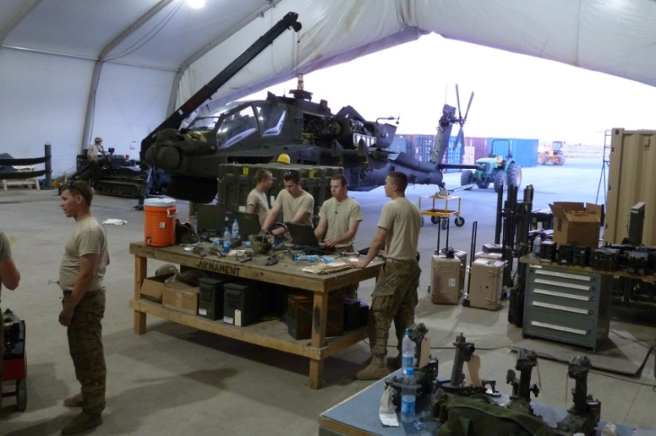
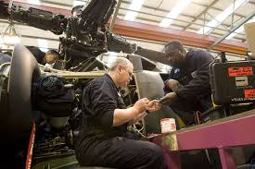
Generating Combat Power:
AC and ARNG Attack/Recon Battalions (ARBs)
Myth: AC has a higher and more cost effective Operational Readiness Rate than ARNG.
Facts:
100% of AC ARB is manned full-time (costly).
AC ARBs are equipped with newer or Factory New airframes requiring significantly less maintenance.
AC ARB parts “window” co-located at Home station.
AC ARB is heavily supplemented by Contract Logistical Support (CLS). CLS has significant reductions pending.
AC “green suits” CANNOT sustain complex maintenance operations without CLS as they spend majority of time NOT maintaining.
Average AC Crew Chief rank is E4, with E5 or higher considered “supervisory”.
Facts (Continued):
Only ≈ 33% of ARNG ARB is manned Full Time by Military Technician and AGRs (inexpensive).
ARNG ARBs have older airframes handed down from the AC requiring significant maintenance.
ARNG ARBs draw parts from Regional “Windows”, therefore, OR rate adversely affected by in-transit time.
ARNG ARBs minimally supplemented by Contract Logistical Support (CLS).
ARNG ARB “green suit” unit members CAN sustain complex maintenance operations through daily maintenance by a highly experienced full-time work force.
Average ARNG full-time Crew Chief rank is E5/E6 and has 15+ years experience.
What is the True Dollar Cost for Mission Capable OR Rates for AC and ARNG ARBs?

