Slide 1
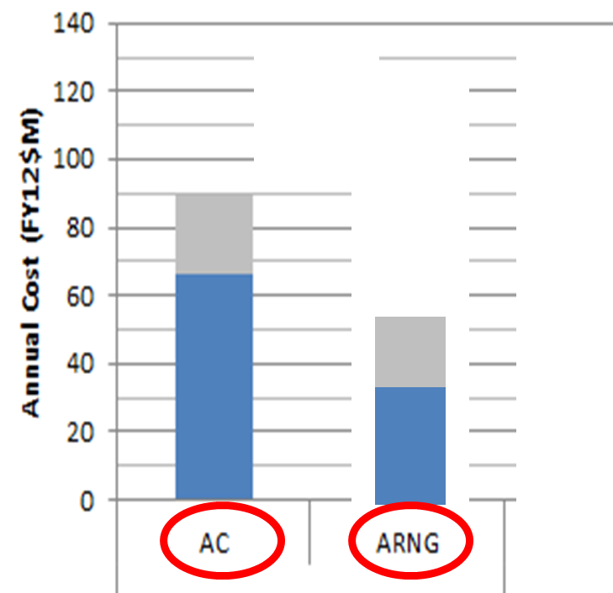
AC and ARNG Attack Reconnaissance Bns
Bottom Line Up Front:
“BOG” is being used to justify removal of ARNG ARBs.
ARNG ARB “BOG” reduced because of AH-64D Fielding and Train Up. (UFTP is 3 months of deployment time.)
The current world situation has reduced the need for intensive ARB BOG time.
8 NG ARBs would be replaced by much more expensive AC ARBs.
All AH-64Ds would be under Direct Control of AC.
This is a huge risk. It leaves no Reserve Force.
Blue = Fixed Operating Cost
Gray = Equipment (Aircraft) Cost.
Notes:
RC ARBs have deployed 14 units; AC ARBs have deployed 64 units
RC # of deployments per unit has varied between 0-2
AC # of deployments has varied between 2-6
Unit size varies from company to battalion; deployment length has varies between 9-15 months
Company-Deployment months accounts for relative unit contribution and deployment length
2 x RC ARBs = 1 x AC ARB
…at 1:3 AC BOG:Dwell and 1:5 RC MOB:Dwell (9 months BOG)
IF RC units never mobilize, 2 RC units cost more than 1 AC unit (yellow boxes)
IF RC units are regularly mobilized, relative RC costs increase further (orange boxes)
RC units – pilots in particular - generally execute more than the typical 39 training days per year, even outside of deployment preparation windows.
RC utility/MEDEVAC units have crucial role in homeland support; attack aviation does not
Additionally, Available RC units in ARFORGEN require additional preparation after mobilization, before they are ready to deploy to surge contingency operations.
The Army has limited capacity to simultaneously mobilize multiple RC units.

Slide 2
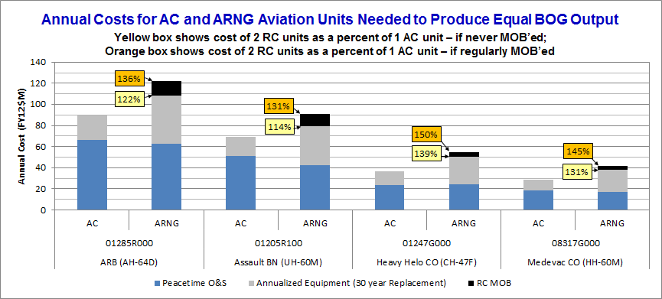
The “Boots on Ground” Argument
ALL ARNG ARBs were unavailable for a 3 Year period during OIF/OEF (2003-2013) due to AH-64D Fielding Schedule
AC AH-64D Fielding was 90+% complete before OIF/OEF began
The Army is “concerned” about the lack of ARNG ARB “BOG” time.
Mobilization Orders and Pre-Mob training mandated by AC.
Unit Fielding Train-up Program (UFTP) reduced each initial NG AH-64D ARB deployment “BOG” 3 months.
NG ARBs have deployed 100% of the times requested.
Discrepancy between AD and RC BOG time has a lot hidden in the “fine print”.
This text allows the creation of a misleading bar graph.
Notes:
RC ARBs have deployed 14 units; AC ARBs have deployed 64 units
RC # of deployments per unit has varied between 0-2
AC # of deployments has varied between 2-6
Unit size varies from company to battalion; deployment length has varies between 9-15 months
Company-Deployment months accounts for relative unit contribution and deployment length
2 x RC ARBs = 1 x AC ARB
…at 1:3 AC BOG:Dwell and 1:5 RC MOB:Dwell (9 months BOG)
IF RC units never mobilize, 2 RC units cost more than 1 AC unit (yellow boxes)
IF RC units are regularly mobilized, relative RC costs increase further (orange boxes)
RC units – pilots in particular - generally execute more than the typical 39 training days per year, even outside of deployment preparation windows.
RC utility/MEDEVAC units have crucial role in homeland support; attack aviation does not
Additionally, Available RC units in ARFORGEN require additional preparation after mobilization, before they are ready to deploy to surge contingency operations.
The Army has limited capacity to simultaneously mobilize multiple RC units.

Slide 3
AC and ARNG Attack Reconnaissance Bns
The Orange Box Text Represents Unit Training MANDATED by Active Duty for NG units prior to arriving in Theater. This training is not required of Active Duty Units. NG units have the same Annual Training Requirements as Active Duty. Why is this Unit Training Required?
The Yellow Box Text is referring to the Gray Area of the Bar Chart. This is the time MANDATED by the ARFORGEN CYCLE produced by Active Duty (FORSCOM). If Active Duty wishes to reduce the time period of the ARFORGEN CYCLE, FORSCOM is capable of doing so.
NG ARBs are Mandated by Army first mobilize to Ft. Hood before deploying to Theater (limiting RC BOG time).
The Army has limited capacity to simultaneously mobilize multiple RC units. (NG ARB BOG time further limited).
The Army has combined 2 RC ARBs (and the costs associated) in comparison 1 AC ARB in order to provide “equivalent” BOG time.
This Chart Show the originally projected 2x AH-64D RC unit Cost.
This Chart shows the CORRECTED cost per AH-64D RC unit. This depiction is necessary for an accurate “apples-to-apples” comparison.
Notes:
RC ARBs have deployed 14 units; AC ARBs have deployed 64 units
RC # of deployments per unit has varied between 0-2
AC # of deployments has varied between 2-6
Unit size varies from company to battalion; deployment length has varies between 9-15 months
Company-Deployment months accounts for relative unit contribution and deployment length
2 x RC ARBs = 1 x AC ARB
…at 1:3 AC BOG:Dwell and 1:5 RC MOB:Dwell (9 months BOG)
IF RC units never mobilize, 2 RC units cost more than 1 AC unit (yellow boxes)
IF RC units are regularly mobilized, relative RC costs increase further (orange boxes)
RC units – pilots in particular - generally execute more than the typical 39 training days per year, even outside of deployment preparation windows.
RC utility/MEDEVAC units have crucial role in homeland support; attack aviation does not
Additionally, Available RC units in ARFORGEN require additional preparation after mobilization, before they are ready to deploy to surge contingency operations.
The Army has limited capacity to simultaneously mobilize multiple RC units.

Slide 4
AC and ARNG Attack Reconnaissance Bns
NG ARB dwell time Mandated by FORSCOM ARFORGEN cycle. It can be changed by FORSCOM.
UFTP reduced each NG AH-64D ARB total BOG by 3 months.
NG ARBs have the ability to mobilize from Home Station. This would reduce costs and increase BOG significantly.
The current world situation has reduced the need for intensive ARB BOG time.
NG ARBs are significantly less expensive when operating at home station than AC ARBs.
This Chart shows the CORRECTED cost per AH-64D RC unit. This depiction is necessary for an accurate “apples-to-apples” comparison.
Notes:
RC ARBs have deployed 14 units; AC ARBs have deployed 64 units
RC # of deployments per unit has varied between 0-2
AC # of deployments has varied between 2-6
Unit size varies from company to battalion; deployment length has varies between 9-15 months
Company-Deployment months accounts for relative unit contribution and deployment length
2 x RC ARBs = 1 x AC ARB
…at 1:3 AC BOG:Dwell and 1:5 RC MOB:Dwell (9 months BOG)
IF RC units never mobilize, 2 RC units cost more than 1 AC unit (yellow boxes)
IF RC units are regularly mobilized, relative RC costs increase further (orange boxes)
RC units – pilots in particular - generally execute more than the typical 39 training days per year, even outside of deployment preparation windows.
RC utility/MEDEVAC units have crucial role in homeland support; attack aviation does not
Additionally, Available RC units in ARFORGEN require additional preparation after mobilization, before they are ready to deploy to surge contingency operations.
The Army has limited capacity to simultaneously mobilize multiple RC units.

Slide 5
AC and ARNG Attack Reconnaissance Bns
AC ARMY IS USING “BOG” as Justification to Remove ARBs from ARNG Aviation.
Generating AH-64 combat power in the RC is significantly more expensive than AC for equal BOG output
The reduced presence of US Armed Forces in Afghanistan, and Complete Withdrawal from Iraq have invalidated the “BOG” argument.
Most ARNG AH-64D ARB Have Completed UFTP. If currently deployed, “BOG” time would be much higher. (Idaho and Texas still need to complete UFTP.)
ARNG ARBs are much less expensive to operate in routine Peacetime Operations. In the Austere Environment of Sequestration, ARNG Attack Aviation makes Fiscal Sense.
Notes:
RC ARBs have deployed 14 units; AC ARBs have deployed 64 units
RC # of deployments per unit has varied between 0-2
AC # of deployments has varied between 2-6
Unit size varies from company to battalion; deployment length has varies between 9-15 months
Company-Deployment months accounts for relative unit contribution and deployment length
2 x RC ARBs = 1 x AC ARB
…at 1:3 AC BOG:Dwell and 1:5 RC MOB:Dwell (9 months BOG)
IF RC units never mobilize, 2 RC units cost more than 1 AC unit (yellow boxes)
IF RC units are regularly mobilized, relative RC costs increase further (orange boxes)
RC units – pilots in particular - generally execute more than the typical 39 training days per year, even outside of deployment preparation windows.
RC utility/MEDEVAC units have crucial role in homeland support; attack aviation does not
Additionally, Available RC units in ARFORGEN require additional preparation after mobilization, before they are ready to deploy to surge contingency operations.
The Army has limited capacity to simultaneously mobilize multiple RC units.

Slide 6
AC and ARNG Attack Reconnaissance Bns
CONCLUSIONS
4 Reasons NG ARBs had Reduced BOG time during 2003–2013
1) Every NG ARB was fielded AH-64Ds (a 3 year process) during this time. Only 1 AC ARB was left to begin the Fielding process prior to OIF.
2) AC had difficulty providing simultaneous Mobilization Training to multiple RC forces. NG ARBs campaigned for a more active role in OIF/OEF, but were not utilized to full extent.
3) AC mandated ARNG ARB Pre-Mobilization Training at Fort Hood. Home Station Training would have been Better, Faster, and Cheaper.
4) ARFORGEN Cycle is determined by FORSCOM (Active Duty).
ARNG ARBs are LESS EXPENSIVE than AC ARBs.
NG Attack Aviation is Experienced, and has proven LOWER ACCIDENT RATES than Active Duty.
Notes:
RC ARBs have deployed 14 units; AC ARBs have deployed 64 units
RC # of deployments per unit has varied between 0-2
AC # of deployments has varied between 2-6
Unit size varies from company to battalion; deployment length has varies between 9-15 months
Company-Deployment months accounts for relative unit contribution and deployment length
2 x RC ARBs = 1 x AC ARB
…at 1:3 AC BOG:Dwell and 1:5 RC MOB:Dwell (9 months BOG)
IF RC units never mobilize, 2 RC units cost more than 1 AC unit (yellow boxes)
IF RC units are regularly mobilized, relative RC costs increase further (orange boxes)
RC units – pilots in particular - generally execute more than the typical 39 training days per year, even outside of deployment preparation windows.
RC utility/MEDEVAC units have crucial role in homeland support; attack aviation does not
Additionally, Available RC units in ARFORGEN require additional preparation after mobilization, before they are ready to deploy to surge contingency operations.
The Army has limited capacity to simultaneously mobilize multiple RC units.

